Slide 1
Few-shot learning in NLP
final presentation
Dawid Przybyliński, Aleksander Podsiad, Piotr Sieńko
Notes:
Pioter

Slide 2
Few-shot learning
Deep learning requires huge amount of data to train
Labelling the data is costly and time consuming
Efficient techniques for undersized samples are needed
Few-Shot Methods
Notes:
Pioter

Slide 3
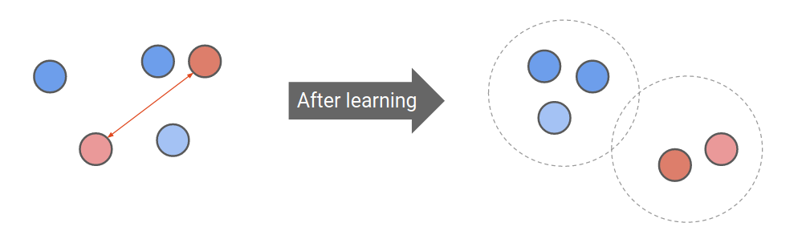
Contrastive learning
Having positive and negative examples, create such an embedding, that distance between instances from the same class is minimized and distance to different classes is maximized
Source: Lilian Weng, Jong Wook Kim, NeurIPS 2021
Notes:
Pioter

Slide 4
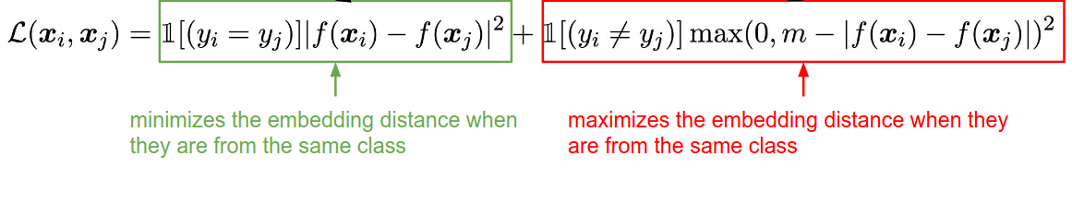
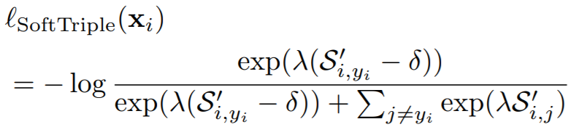
Contrastive learning loss functions
Basic Contrastive Loss:
SoftTriple loss:
Source: R. Zhang et al, NAACL 2022
Source: Qi Qian et al. 2019
Notes:
Pioter

Slide 5
Dataset
IMDb: Large Movie Review Dataset
25,000 training, 25,000 test
Balanced dataset - 50% positive, 50% negative
Review example:
“If you like original gut wrenching laughter you will like this movie…” - positive
“So im not a big fan of Boll's work but then again not many are…” - negative
Notes:
Pioter

Slide 6
Model I - Contrastive + voting
BERT embedding used as an input to the network
Contrastive loss applied to train the network for pairs discrimination
Similarity is estimated for each (x_test, x_train) pair
Final class is determined by voting
BERT embedding
Contrastive network learning (training data)
Pairs comparison (test and training data)
Voting
Notes:
Pioter

Slide 7
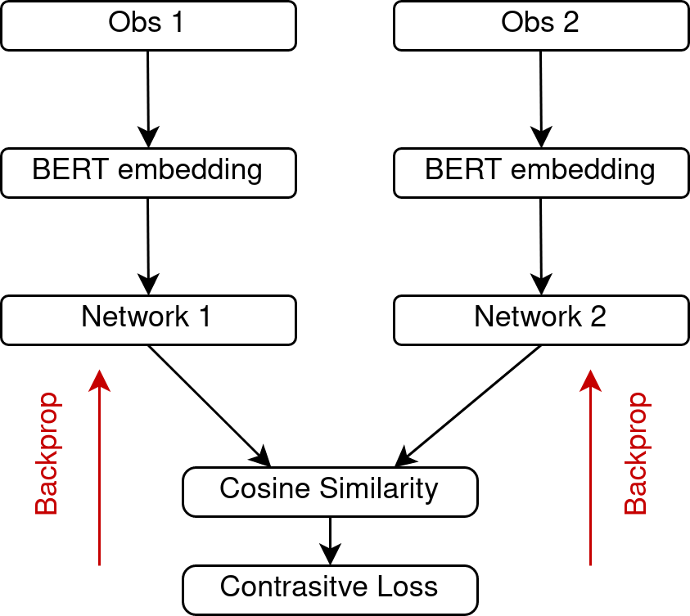
Model I - architecture
Siamese networks, cosine similarity and contrastive loss are utilized
Examples from the test set are compared with the examples from the training set - the network determines whether they are from the same class or not
Having training labels, we can perform voting and define predicted class
Notes:
Pioter

Slide 8
Model I - experiments
Training set - random sample of 100 observations out of 200 dedicated for training
Test set - 9000 observations
900,000 comparisons during model evaluation
Repeated 4 times
Accuracy:
avg - 77.0%, std - 0.9%
F1 Score:
avg - 77.4%, std - 1.4%
on the IMDb sentiment dataset
Notes:
Pioter

Slide 9
Model II - RoBERTa
RoBERTa-base/large
using pre-trained model for the downstream task
fine-tuning the model for the specific dataset and task
contrastive learning with soft-triple loss function
learning on small number of samples (from 10 to 100)
mainly for comparison
Downstream task
Fine tuning
(Contrastive learning)
Notes:
Olek

Slide 10
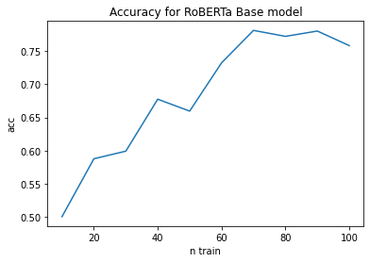
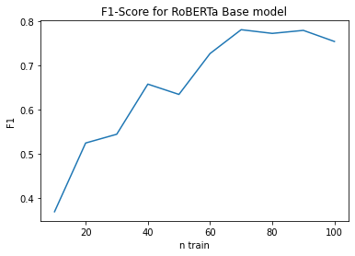
Model II - experiments RoBERTa-base
For 100 training samples and 9000 test samples
accuracy score: 0.726
F1 score: 0.715
embedding size: 768
Notes:
Olek

Slide 11
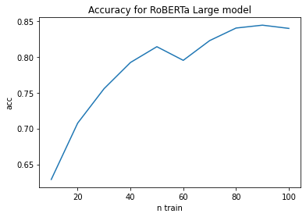
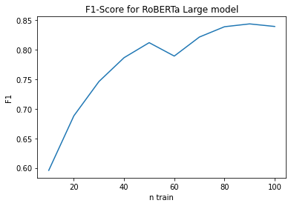
Model II - experiments RoBERTa-large
For 100 training samples and 9000 test samples
accuracy score: 0.838
F1 score: 0.837
embedding size: 1024
Notes:
Olek

Slide 12
Model III - similarities of SimCSE embeddings
SimCSE (Simple Contrastive Learning of Sentence Embeddings) is a contrastive learning Python framework, which offers embeddings and calculating cosine similarity measure between them.
Github repository: https://github.com/princeton-nlp/SimCSE
using model pre-trained using contrastive learning
new observation is classified by voting of n closest observation from labeled dataset
training datasets requires at most 50 observations
Notes:
Dawid

Slide 13
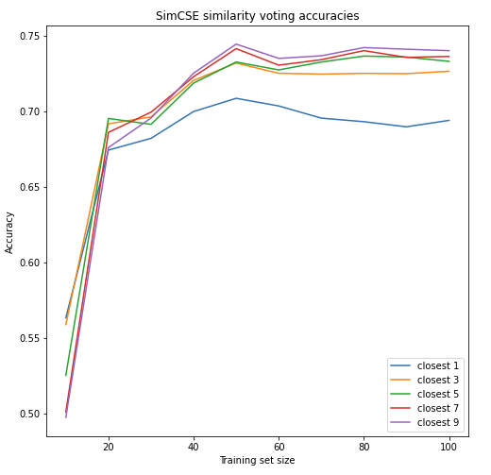
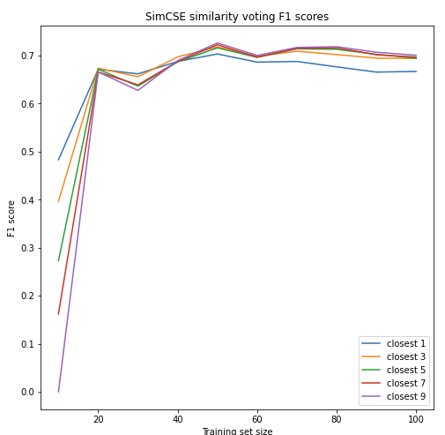
Model III - similarities of SimCSE embeddings
Notes:
Dawid

Slide 14
Model IV - Bag of Words
Data preprocessing
removing stop-words and words containing alphanumeric symbols
lemmatization using NLTK and WordNet
creating the Bag-of-Words embedding
cropping the vectors based on word frequencies
Multi-Layer Perceptron as the classification head
Lemmatization
BoW embedding
Multi-Layer Perceptron
Notes:
Olek

Slide 15
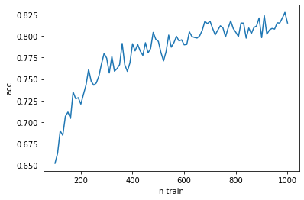
Model IV - experiments Bag of Words
Remarks:
words that occur in less than 1% of sentences are removed
words that occur in more than 50% of sentences are also removed
training this model with << 100 samples does not produce satisfying results
For 100 training samples
and 2000 test samples
accuracy score: 0.663
F1 score: 0.716
Notes:
Olek

Slide 16
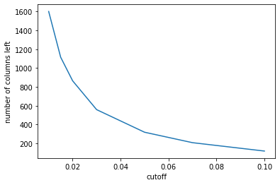
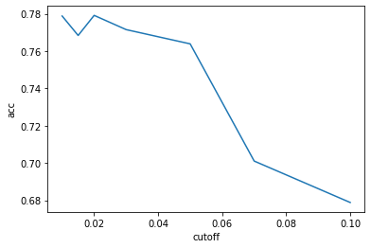
Model IV - experiments Bag of Words
Notes:
Olek

Slide 17
Experiments summary
Model | avg Accuracy | avg F1 | n train
BERT Contrastive + voting | 77.0% | 77.4% | 100
RoBERTa large + soft-triple loss | 83.8% | 83.7% | 100
SimCSE embeddings + voting | 74.5% | 70.0% | 100
Bag of Words + MLP | 66.3% | 71.6% | 100
Most of the tests were done with semi cross-validation having 2 or 3 folds
Most testing datasets had 9000 samples (depending on model)
Experiment were additionally carried out multiple times
Notes:
Olek

Slide 18
Plans for next project
Expanding on the idea of voting with contrastive loss function
Usage of data augmentation
Tests for more loss functions
Transfer learning with new data sources
IMDb: Large Movie Review Dataset - 25,000 training, 25,000 test
Amazon Review Polarity Dataset - 1,800,000 training, 200,000 test
Yelp Review Polarity Dataset - 280,000 training, 19,000 test
Notes:
Olek

Slide 19
References
Generalizing from a Few Examples: A Survey on Few-Shot Learning (Wang, Yao, Kwok, Ni, 2020) https://arxiv.org/abs/1904.05046
Distributed Representations of Words and Phrases and their Compositionality (Mikolov, Sutskever, Chen, Corrado, Dean) http://arxiv.org/abs/1310.4546
X. Zhang and J. Zhao and Y. LeCun 2015. Character-level Convolutional Networks for Text Classification, https://doi.org/10.48550/arXiv.1509.0162
Lilian Weng, Jong Wook Kim, Self-Supervised Learning: Self-Prediction and Contrastive Learning, NeurIPS 2021, https://neurips.cc/media/neurips-2021/Slides/21895.pdf
Zhang et al. Contrastive Data and Learning for Natural Language Processing, NAACL 2022, https://contrastive-nlp-tutorial.github.io/files/contrastive_nlp_tutorial.pdf
A survey on semi-supervised learning (Van Engelen, Jesper E and Hoos, Holger H) https://doi.org/10.1007/s10994-019-05855-6
Realistic Evaluation of Deep Semi-Supervised Learning Algorithms (Oliver, Odena, Raffel, Ekin D. Cubuk & Ian J. Goodfellow) https://arxiv.org/abs/1804.09170
Chen et al. A Simple Framework for Contrastive Learning of Visual Representations, 2022
Applying SoftTriple Loss for Supervised Language Model Fine Tuning (Sosnowski, Wróblewska, Gawrysiak, 2021) https://arxiv.org/abs/2112.08462.
https://kevinmusgrave.github.io/pytorch-metric-learning/losses/#softtripleloss

